Slide 1
CSTA Spring Conference
Introduction to Object-Oriented Analysis
and
Object-Oriented Design
Mitchel G. Fry

Slide 2
Overview
Object-oriented programming (OOP) is a way to organize
and conceptualize a program as a set of interacting objects.
In the overview section, we will get an introduction to:
Key Object-Oriented Systems concepts
Software Lifecycle Basics
OOA/OOD basic tools

Slide 3
Module Map
Key Object-Oriented Systems Concepts
  Objects and Classes
  Encapsulation
  Methods and Variables
  Inheritance
  Message Passing and Polymorphism
Basic Software Lifecycle Concepts
Introduction to OOA/OOD

Slide 4
Object-Oriented Programming
Object-oriented programming (OOP) is a way to organize and
conceptualize a program as a set of interacting objects.
The programmer defines the types of objects that will exist.
The programmer creates object instances as they are needed.
The programmer specifies how these various object will communicate and interact with each other.

Slide 5
What is an Object?
Real-world objects have attributes and behaviors.
Examples:
Dog
  Attributes: breed, color, hungry, tired, etc.
  Behaviors: eating, sleeping, etc.
Bank Account
  Attributes: account number, owner, balance
  Behaviors: withdraw, deposit

Slide 6
Software Objects
Writing software often involves creating a computational model
of real-world objects and processes.
Object-oriented programming is a methodology that gives programmers tools to make this modeling process easier.
Software objects, like real-world objects, have attributes and behaviors.
Your best bet is to think in terms as close as possible to the real world; trying to be tricky or cool with your system is almost always the wrong thing to do (remember, you can’t beat mother nature!)

Slide 7
Software Objects - Cont’d
In traditional programming languages (Fortran, Cobol, C, etc)
data structures and procedures are defined separately.
In object-oriented languages, they are defined together.
  An object is a collection of attributes and the behaviors that operate on them.
Variables in an object are called attributes.
Procedures associated with an object are called methods.
Bank
Account
Account
Account
number:
balance:
deposit()
withdraw()

Slide 8
Classes
The definitions of the attributes and methods of an object are
organized into a class. Thus, a class is the generic definition
for a set of similar objects (i.e. Person as a generic definition
for Jane, Mitch and Sue)
A class can be thought of as a template used to create a set of objects.
A class is a static definition; a piece of code written in a programming language.
One or more objects described by the class are instantiated at runtime.
The objects are called instances of the class.

Slide 9
Classes - Cont’d
Each instance will have its own distinct set of attributes.
Every instance of the same class will have the same set of attributes;
  every object has the same attributes but,
  each instance will have its own distinct values for those attributes.
Notes:
Note: There are other terms that are synonymous with state variables: fields and data members. There are additional terms that represent similar ideas, but have subtle differences: such as variables (includes locals, parameters and automatic vars, and all state variables), instance variables (or instance fields, or instance members) which represent a subset of the state variables, and class variables (or class fields, or class members) which represent a difference subset of the state variables. These subsets will be explored in later sections of this course.

Slide 10
Bank Example
The "account" class describes the attributes and behaviors of bank accounts.
The “account” class defines two state variables (account number and balance) and two methods (deposit and withdraw).
class: Account
number:
balance:
deposit()
withdraw()

Slide 11
Bank Example - Cont’d
When the program runs there will be many instances of the account class.
Each instance will have its own account number and balance (object state)
Methods can only be invoked .
Instance #1
number: 054
balance: $19
Instance #2
number: 712
balance: $240
Instance #3
number: 036
balance: $941

Slide 12
Encapsulation
When classes are defined, programmers can specify that
certain methods or state variables remain hidden inside the
class.
These variables and methods are accessible from within the class, but not accessible outside it.
The combination of collecting all the attributes of an object into a single class definition, combined with the ability to hide some definitions and type information within the class, is known as encapsulation.
Visible Methods
Hidden State Variables and Methods
Visible Variables
Class Definition
Notes:
OOP encapsulation is roughly analogous to only allowing a user to access data in a database via predefined stored procedures.
Users can access the data, but not directly and without having to have direct knowledge of its structure.

Slide 13
Graphical Model of an Object
Instance variables
balance()
withdraw()
theBalance
deposit()
acctNumber
Methods
accountNumber()
State variables make up the nucleus of the object. Methods surround and hide (encapsulate) the state variables from the rest of the program.

Slide 14
Instance Methods and Instance Variables
The methods and variables described in this module so far are
know as instance methods and instance variables.
These state variables are associated with the one instance of a class; the values of the state variables may vary from instance to instance.
Instance variables and instance methods can be public or private.
It is necessary to instantiate (create an instance of) a class to use it’s instance variables and instance methods.
Notes:
Note: Class variables and methods are declared with the static keyword in Java.

Slide 15
Class Methods and Class Variables
In addition to instance methods and instance variables, classes
can also define class methods and class variables.
These are attributes and behaviors associated with the class as a whole, not any one instance.
Class variables and class methods can be public or private.
It is not necessary to instantiate a class to use it’s class variables and class methods.
Notes:
Note: Class variables and methods are declared with the static keyword in Java.

Slide 16
Class Variables
A class variable defines an attribute of an entire class.
In contrast, an instance variable defines an attribute of a single instance of a class.
instance variables
Account
class variable
count: 3
printCount()
num: 054 bal: $19
num: 712 bal: $240
num: 036 bal: $941
Class method

Slide 17
Inheritance
The advantage of making a new class a subclass is that it will
inherit attributes and methods of its parent class (also called
the superclass).
Subclasses extend existing classes in three ways:
  By defining new (additional) attributes and methods.
  By overriding (changing the behavior) existing attributes and methods.
  By hiding existing attributes and methods.

Slide 18
Subclasses
When a new class is developed a programmer can define it to
be a subclass of an existing class.
Subclasses are used to define special cases, extensions, or other variations from the originally defined class.
Examples:
Terrier can be defined as a subclass of Dog.
SavingsAccount and CheckingAccount can be derived from the Account class (see following slides).
Generic Class for Dog
With general attributes and behaviors for all dogs.
Terrier is derived
from Dog
Specific Class for Terrier
With new attributes and behaviors specific to the Terrier breed.
Notes:
Note: Derived from implies superclass-subclass relationship, i.e. SavingsAccount would be a subclass of Account.
Examples:
Terrier can be defined as a subclass of Dog.
SavingsAccount and CheckingAccount can be derived from the Account class.

Slide 19
New Account Types - Cont’d
Suppose we define SavingsAccount and CheckingAccount
as two new subclasses of the Account class.
class SavingsAccount
extends Account {
method rate() {…}
}
class Account {
method acctNum() {…}
method balance() {…}
method deposit() {…}
method withdraw() {…}
}
class CheckingAccount
extends Account {
method withdraw() {…}
}

Slide 20
New Account Types - Cont’d
Account
SavingsAccount
CheckingAccount
acctNum()
acctNum()
acctNum()
balance()
balance()
balance()
deposit()
deposit()
deposit()
withdraw()
withdraw()
withdraw()
rate()
withdraw()
No new code has to be written for deposit() and other methods, they are inherited from the superclass.
Notes:
Note: The new version of withdraw() in the CheckingAccount OVERRIDES the method of withdraw() in Account.

Slide 21
Messages
Messages are information/requests that objects send to other objects (or to themselves).
Message components include:
  The name of the object to receive the message.
  The name of the method to perform.
  Any parameters needed for the method.
Manager
Employee
Message
To: Employee
Method: getHired
Parameters: salary = $45,000, start_date = 10/21/99

Slide 22
Benefits of Messages
Message passing supports all possible interactions between
two objects.
Message passing is the mechanism that is used to invoke a method of the object.
Objects do not need to be part of the same process or on the same machine to interact with one another.
Message passing is a run-time behavior, thus it is not the same as a procedure call in other languages (compile-time).
  The address of the method is determined dynamically at run-time, as the true type of the object may not be known to the compiler.

Slide 23
Polymorphism
Polymorphism is one of the essential features of an object-
oriented language; this is the mechanism of decoupling the
behavior from the message.
The same message sent to different types of objects results in:
  execution of behavior that is specific to the object and,
  possibly different behavior than that of other objects receiving the same message.
Example: the message draw() sent to an object of type Square and an object of type Circle will result in different behaviors for each object.

Slide 24
Polymorphism – Cont’d
There are many forms of Polymorphism in object-oriented
languages, such as:
True Polymorphism: Same method signature defined for different classes with different behaviors (i.e. draw() for the Classes Circle and Square)
Parametric Polymorphism: This is the use of the same method name within a class, but with a different signature (different parameters).
Overloading: This usually refers to operators (such as +,-,/,*, etc) when they can be applied to several types such as int, floats, strings, etc.
Overriding: This refers to the feature of subclasses that replace the behavior of a parent class with new or modified behavior.

Slide 25
OO Concepts Summary
Object-oriented programming is a way of conceptualizing a program as groups of objects that interact with one another.
A class is a general template used to create objects.
The combination of collecting all the attributes of an object into a single class definition, combined with the ability to hide some definitions within the class, is known as encapsulation.
Classes can also define class variables and class methods which are attributes and methods associated with the class as a whole.
Inheritance allows classes to “inherit” attributes and methods from their base (parent) class. This provides a clean mechanism for code re-use and extension.

Slide 26
Module Map
Key Object-Oriented Systems Concepts
Basic Software Lifecycle Concepts
  Software Lifecycles
  Common Lifecyle Activities
  Common Lifecyle Flows
Introduction to OOA/OOD

Slide 27
Software Lifecycles
Software lifecycles describe the evolution of a software
project from conception of the need for a software system to
the retirement or replacement of the resulting system.
Two key dimensions of a specific lifecycle are:
The collection of activities to be done
The flow or sequencing of those activities

Slide 28
Common Lifecycle Activities
Project Charter (definition): General description or problem statement, top level business scenarios.
Analysis: Systems level, low detail, problem space oriented. Results in Requirements/Specification document.
Design: Implementation level, high detail, solution space oriented. Results in Software design/model document.
Implementation: Coding, testing, UI, data design, documentation. Results in deliverable product.
Delivery: Configuration, training, maintenance, product evolution planning.
Product end of life planning: Replacement

Slide 29
Common Lifecycle Flows
Lifecycle flows (there are just about as many of these as there
are software projects…) can generally be characterized as one
of the following types:
Sequential
  Waterfall method, Structured Analysis & Design
Iterative, Spiral and Recursive Methods
  There are a huge variety of these
  “Agile” or “LightWeight” Software Methods fit into this class
Parallel Effort
Unmanaged, Chaotic

Slide 30
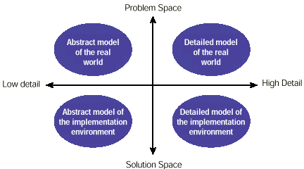
Analysis and Design Space

Slide 31
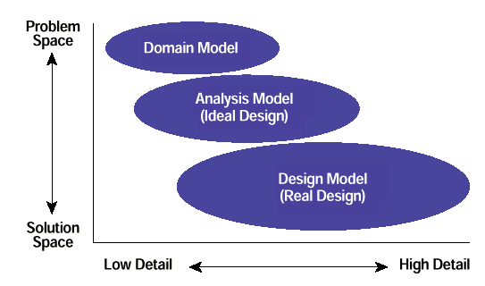
Analysis and Design Space - Cont’d

Slide 32
Module Map
Key Object-Oriented Systems Concepts
Basic Software Lifecycle Concepts
Introduction to OOA/OOD
  Scenarios and Use Cases
  CRC’s
  Sequence Diagrams
  Class Diagrams
  UML Models

Slide 33
Use Cases
Use cases describe the basic business logic of an application.
Use cases typically written in structured English or Diagrams
Represent potential business situations of an application
Describes a way in which a real-world actor – a person, organization, or external system – interacts with the application.
For example, the following would be considered use cases for a
university information system:
Enroll students in courses
Output seminar enrolment lists
Remove students from courses
Produce student transcripts.

Slide 34
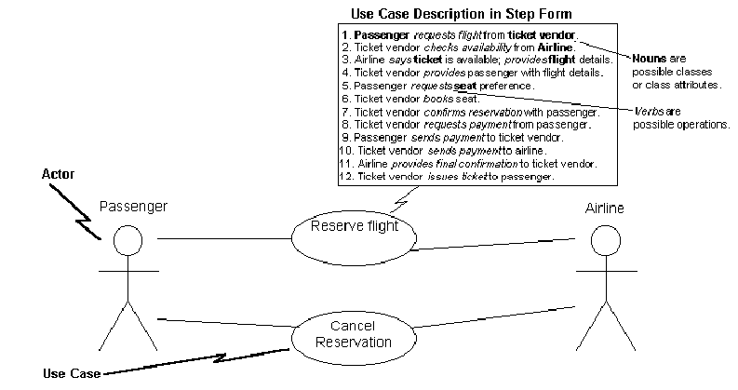
Use Cases Diagrams

Slide 35
Class Responsibility Collaborator Cards
A CRC model is a collection of CRC cards that represent whole or part of an application or problem domain
The most common use for CRC models is to gather and define the user requirements for an object-oriented application
The next slide presents an example CRC model for a shipping/inventory control system, showing the CRC cards as they would be placed
Note the placement of the cards: Cards that collaborate with one another are close to each other, cards that don’t collaborate are not near each other

Slide 36
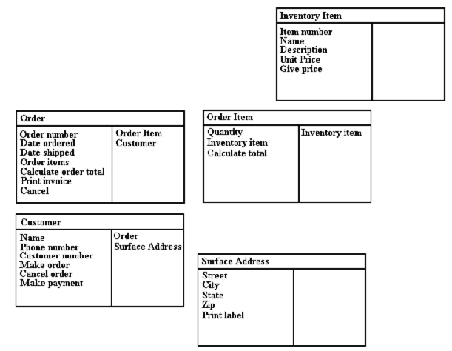
CRC Example
Class Information
Methods and Attributes
Collaborators

Slide 37
CRC Card Layout
Class Name:
Parent Class:
Subclasses:
Attributes:
Collaborators (Sends Messages to):
Responsibilities:

Slide 38
Sequence Diagrams
Traditional sequence diagrams show:
The objects involved in the use case
The messages that they send each other
Return values associated with the messages
Sequence diagrams are a great way to review your work as
they force you to walk through the logic to fulfill a use-case
scenario and match the responsibilities and collaborators in
CRC cards.

Slide 39
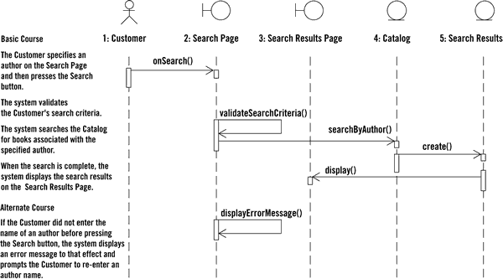
Sequence Diagrams

Slide 40
Class Diagrams
Class diagrams (object models) are the mainstay
of OO modeling
They are used to show both what the system will be able to do (analysis) and how it will be built (design)
Class diagrams show the classes of the system and their interrelationships
  Inheritance
  Aggregation
  Associations

Slide 41
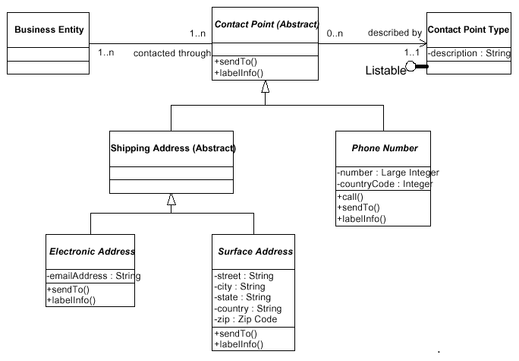
Class Diagram

Slide 42
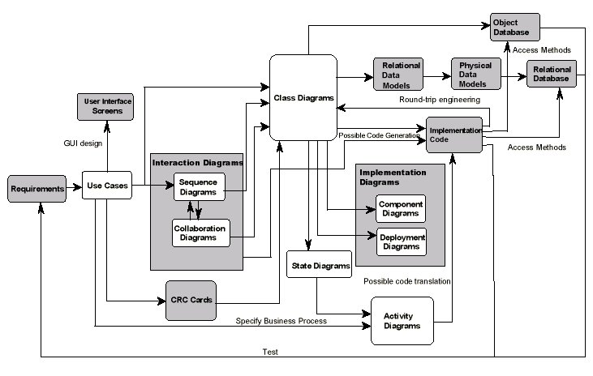
UML Models

Slide 43
OOA/OOD Exercise # 1
This exercise is to learn an object-oriented analysis and design
(OOA/OOD) methodology known as responsibility driven
design.
Using the real world structure of a instant teller machine, model the objects involved (attributes and behaviors) and their relationships (who sends messages to whom).
Each object is represented on a 3x5 note card.
You focus on identifying the various responsibilities that are needed for the operation of an instant teller system and who (what object) should implement those responsibilities.
This is much like laying out an organizational flow chart. Layout the cards on the table or tape them on a wall. Re-arrange, add new cards and throwaway cards until it looks and feels “right” to you.

